Slide 1
BikesOnline
Australia
Data analytics approach
Nguyen An Quang

Slide 2
Agenda
Table of Contents
Introduction
Data Exploration
Model Development
Interpretation

Slide 3
Agenda
Focus Areas
Age Group
Car Ownership
Wealth Segment
Job Industry
State

Slide 4
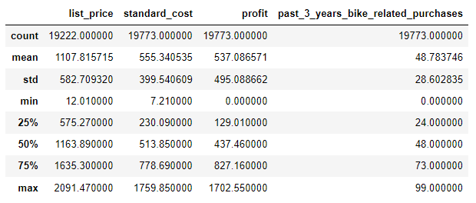
Introduction
Data Cleaning
Excel was used to identify the data quality issues.
The table data were cleaned, pre-processed, and merged into one table in Python.
Table: Statistical details of the financial values in the dataset

Slide 5
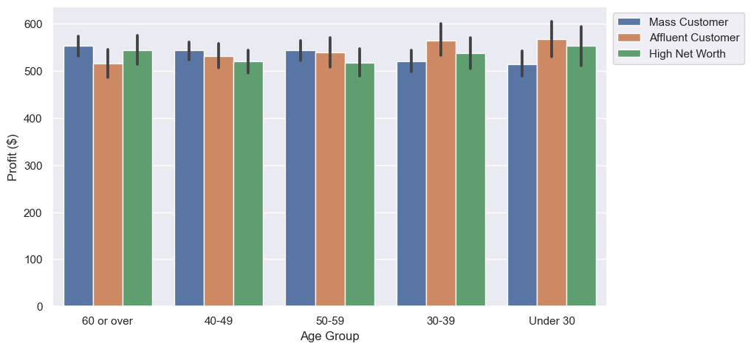
Data Exploration
Gender & Age factors
Age group 30-39 has the highest contribution of age group and wealth segment to profit.

Slide 6
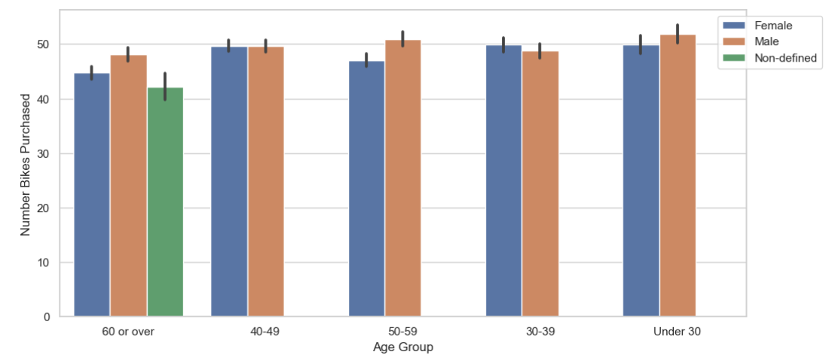
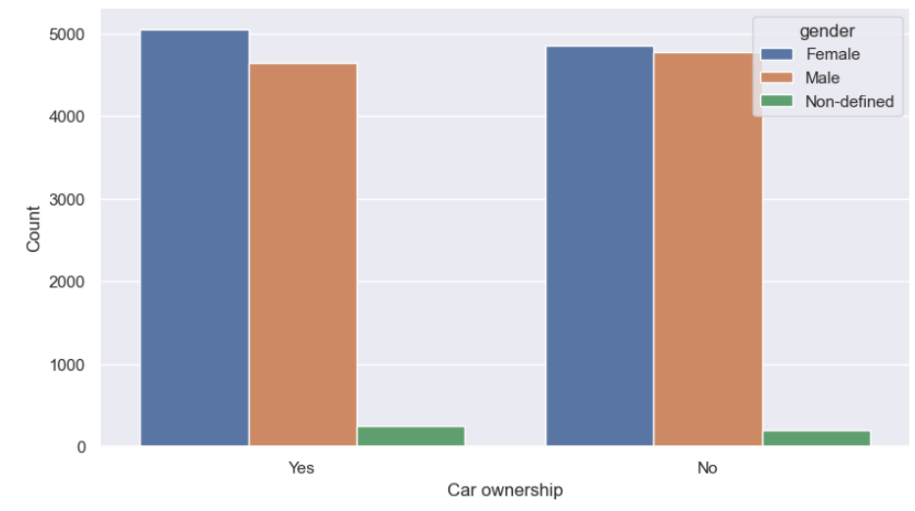
Data Exploration
Gender & Age factors
In the last 3 years, the most purchases are from under 30 males.
Car ownership is more positive among males and more negative among females.

Slide 7
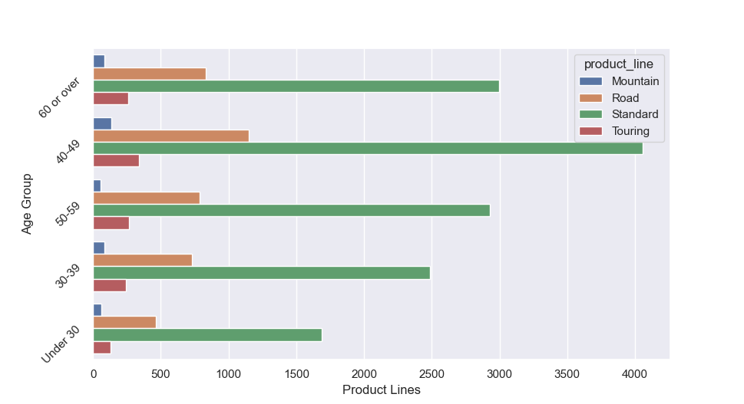
Data Exploration
Gender & Age factors
Standard bikes are ordered the most by all age groups whereas Mountain bikes are the lowest.
Road bikes are the second most ordered items followed by Touring bikes which are famous among the age group 40-49.

Slide 8
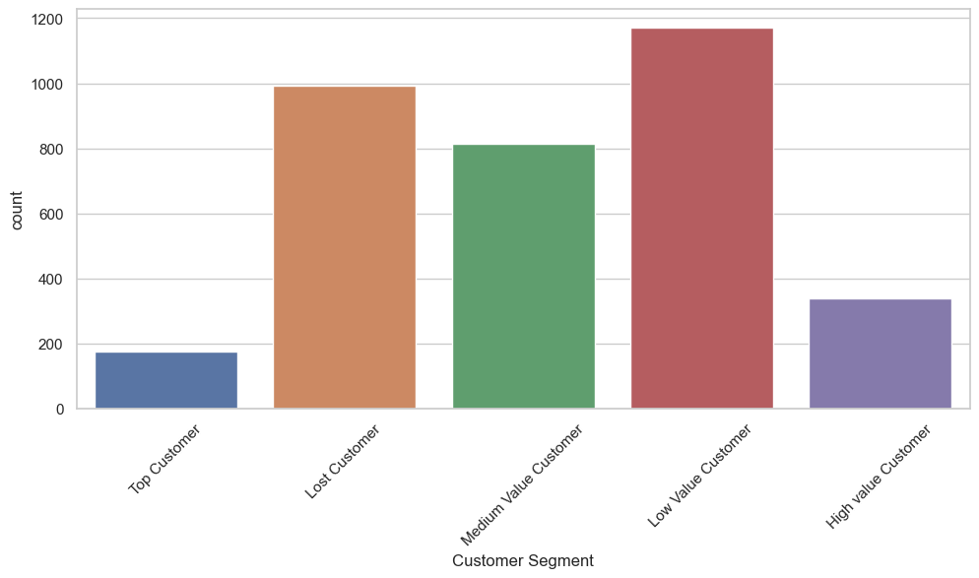
Model Development
RFM Analysis
Most of the customers are Low Value customers which should be a concern for further analyses.
For new customers, the characteristics and tendencies of Top, High Value and Medium Value customers will be considered.

Slide 9
Model Development
RFM Analysis
RFM Analysis evaluates customers based on:
Recency: Last purchase date.
Frequency: Purchase frequency.
Monetary Value: Total spending.
Purpose:
Segment customers by value.
Target high-value customers.
Personalize marketing strategies.

Slide 10
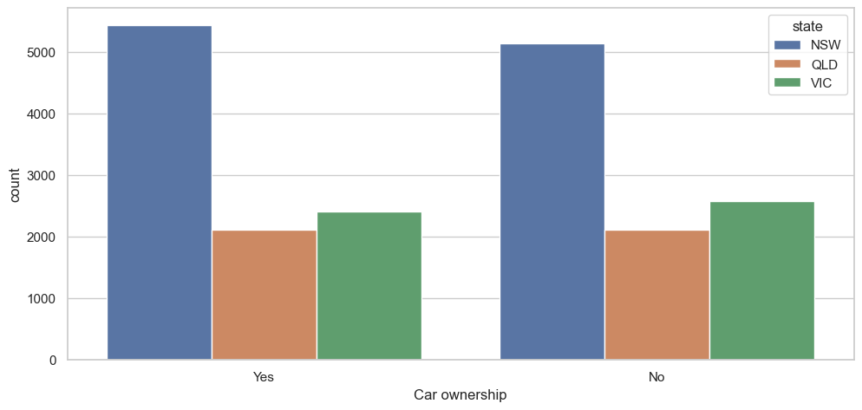
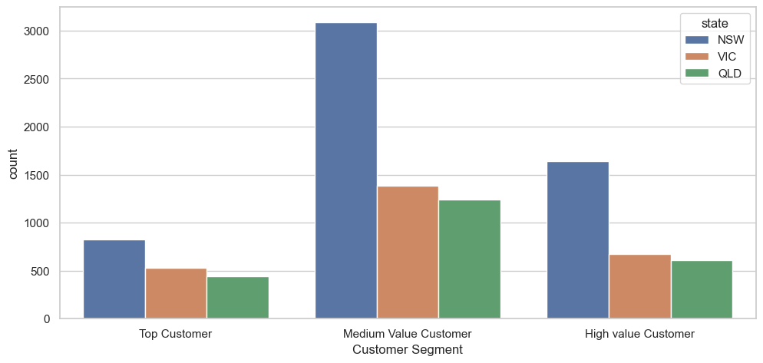
Model Development
RFM Analysis
Majority of the important customers are from New South Wales, followed by QLD and VIC.
The ownership of the car has almost equal count in all the states.

Slide 11
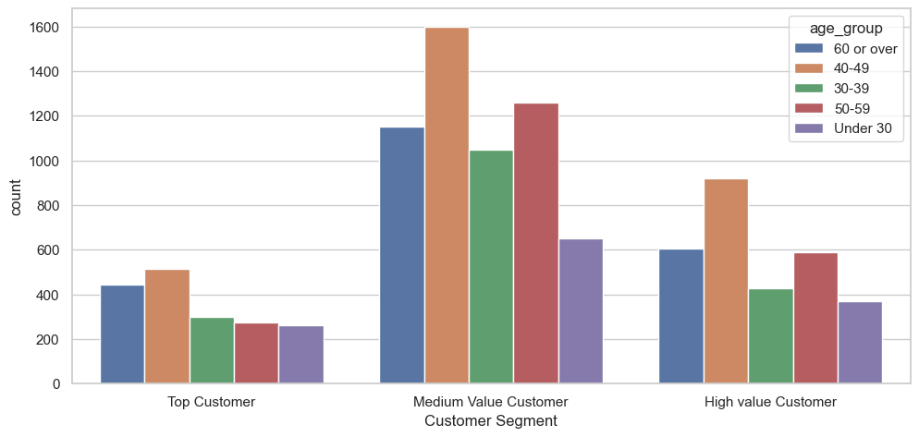
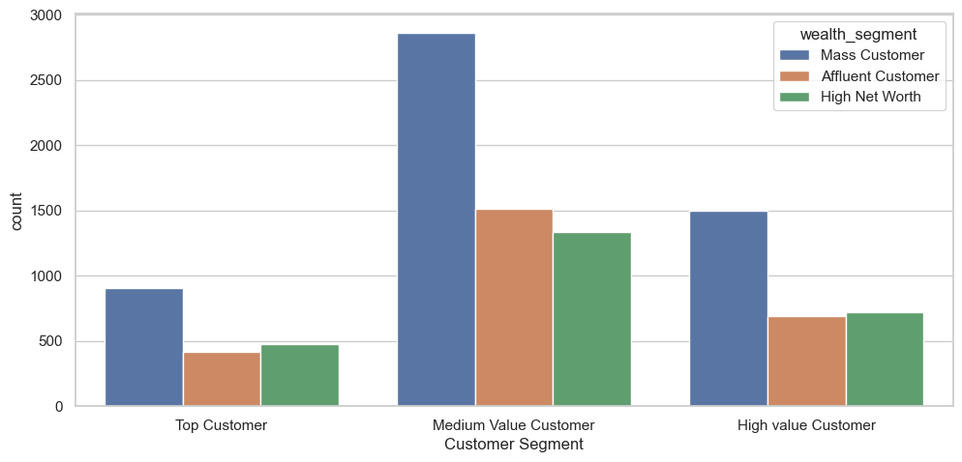
Model Development
RFM Analysis
Most of important customers are in the age group 40-49 and 60 or over.
High Net worth and Affluent customers have less contribution than mass customers.

Slide 12
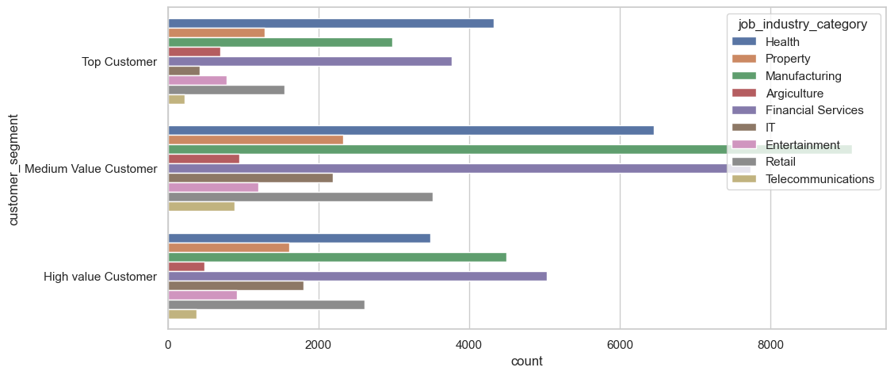
Model Development
RFM Analysis
In all three segments, Health, Financial Services and Manufacturing are the highest profit generating industries.
Retail and IT industries also have noticeable contribution among three segments.

Slide 13
Interpretation
Potential Customer Classification
Top 3 job industries to target – Health, Manufacturing, and Financial Services
People are 40 and over should be the main target.
Wealth segment and car ownership have less impact on purchase. Mass customers are the main consumer.
New South Wales has a big potential market for growth.

Slide 14
Thank You

